Slide 1


Tutorial 03 – Imitaiton Learning
02360765 PARLAI Spring 2026

Slide 2
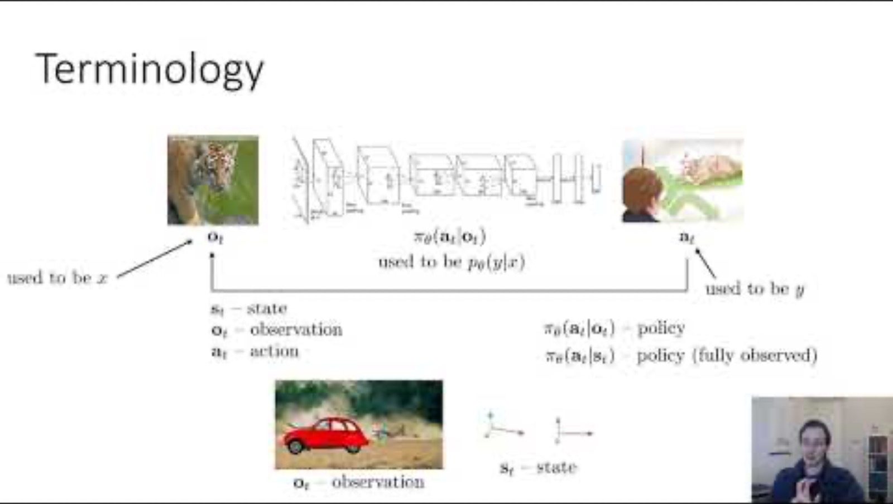
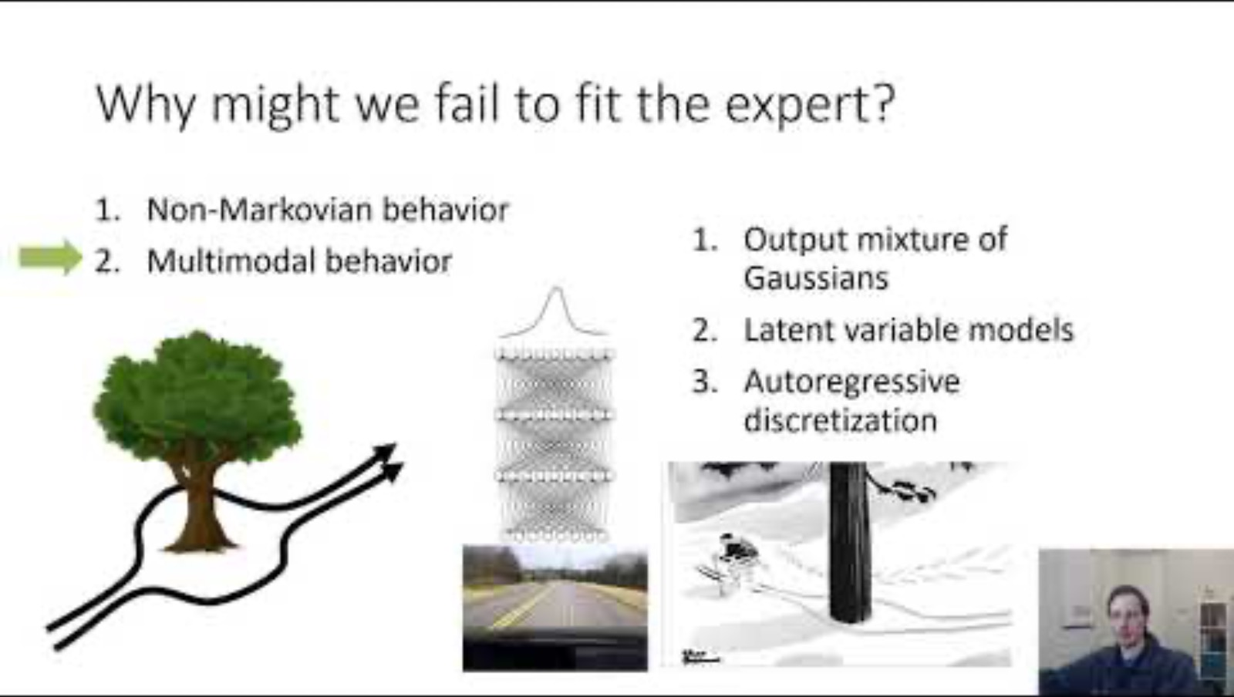
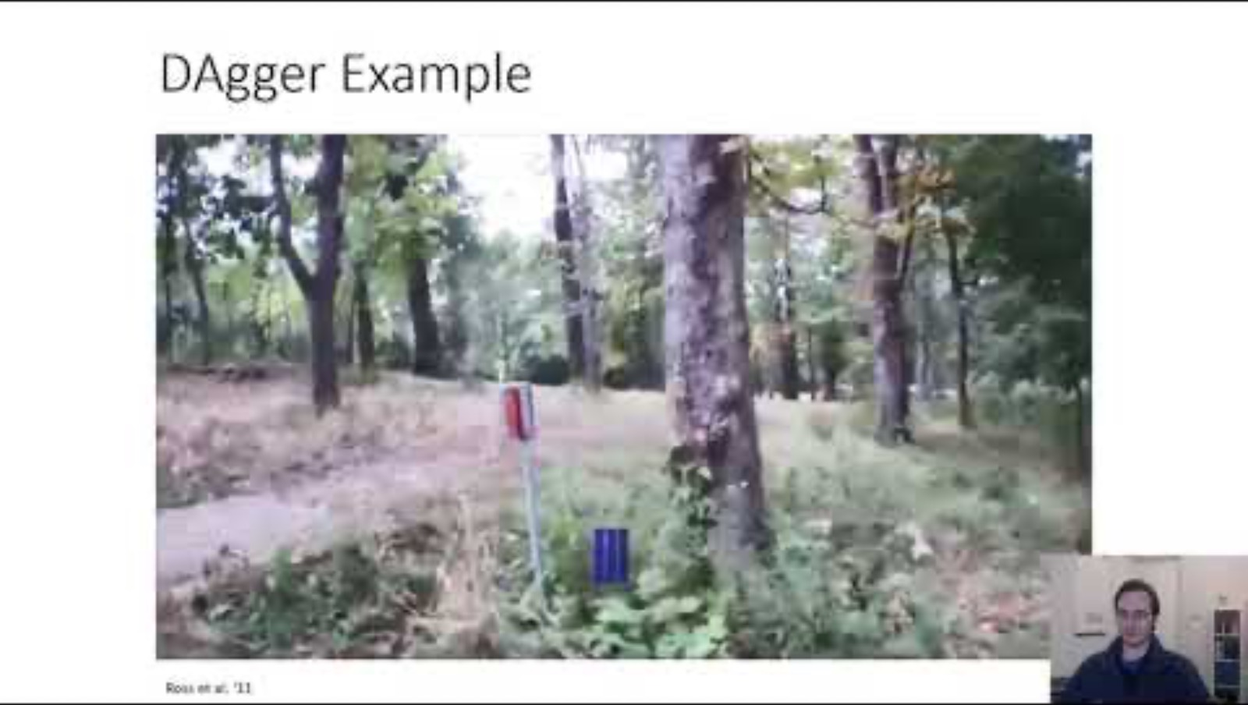
Recommended Viewing
This tutorial only scratches the surface. Watch these for more.
Part 1
Part 2
Part 3

Slide 3
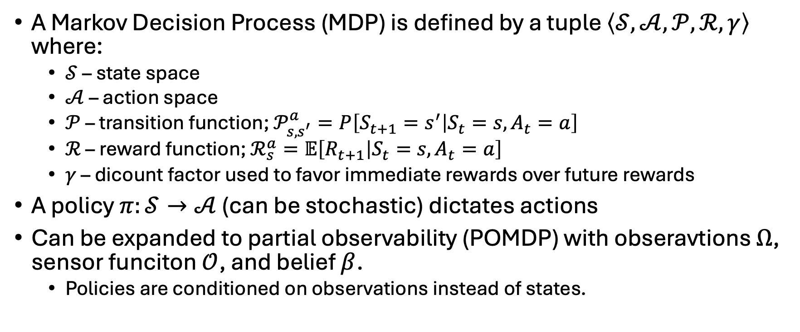
Recap: MDP
A Markov Decision Process (MDP) is defined by a tuple $\left\langle 𝒮,𝒜,𝒫,ℛ,γ\right\rangle$ where:
$𝒮$ – state space
$𝒜$ – action space
$𝒫$ – transition function; $𝒫_{s,s^{′}}^{a}=P\left[S_{t+1}=s^{′} | S_{t}=s, A_{t}=a\right]$
$ℛ$ – reward function; $ℛ_{s}^{a}=𝔼\left[R_{t+1} | S_{t}=s,A_{t}=a\right]$
$γ$ – dicount factor used to favor immediate rewards over future rewards
A policy $π:𝒮→𝒜$ (can be stochastic) dictates actions
Can be expanded to partial observability (POMDP) with obseravtions $Ω$, sensor funciton $𝒪$, and belief $β$.
Policies are conditioned on observations instead of states.

Slide 4
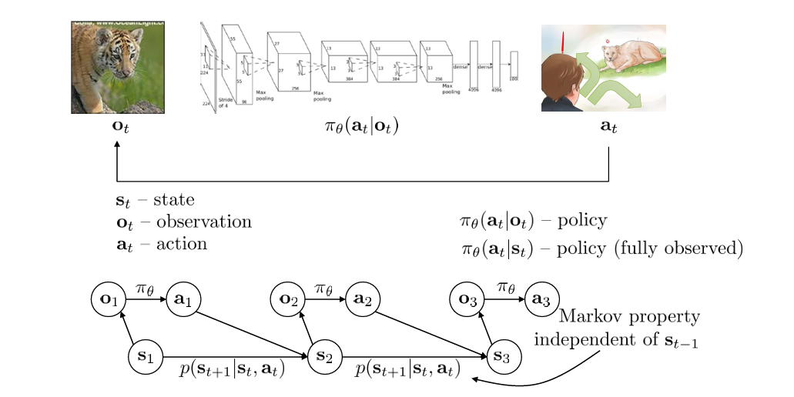
The Decision-Making Problem

Slide 5
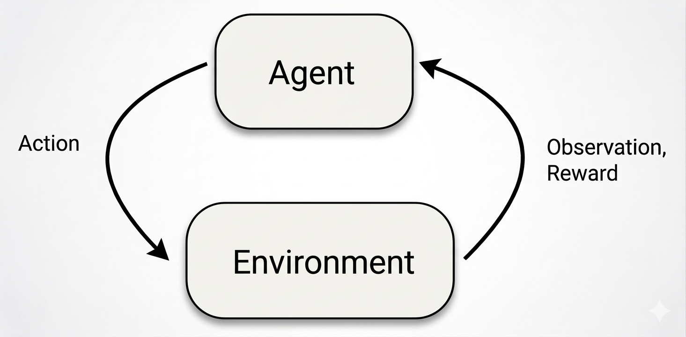
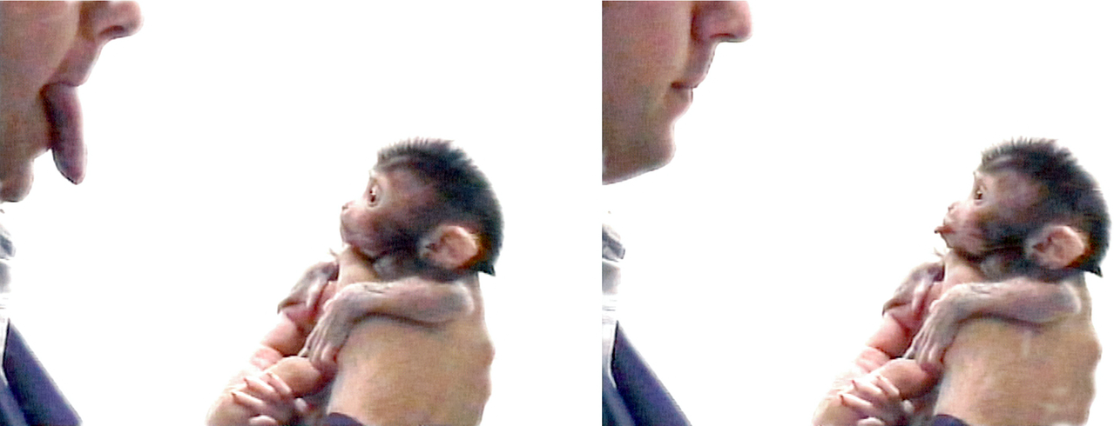
What is Imitation learning (IL)?
In reinforcement learning (RL), the agent acts in the environment, receives observations and rewards, and learns from these experiences.
In Imitation learning (IL), the agent learns from expert demonstrations.
RL
IL

Slide 6
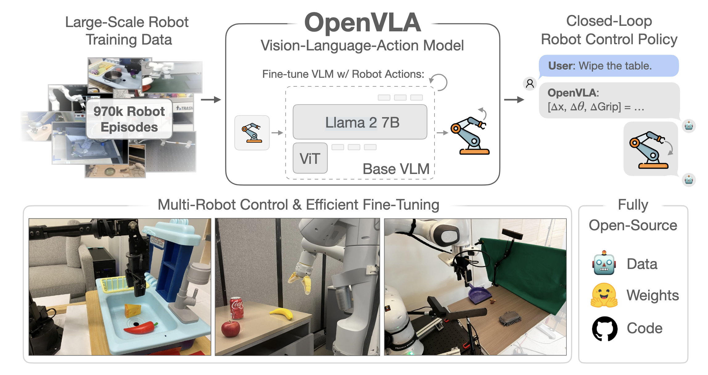
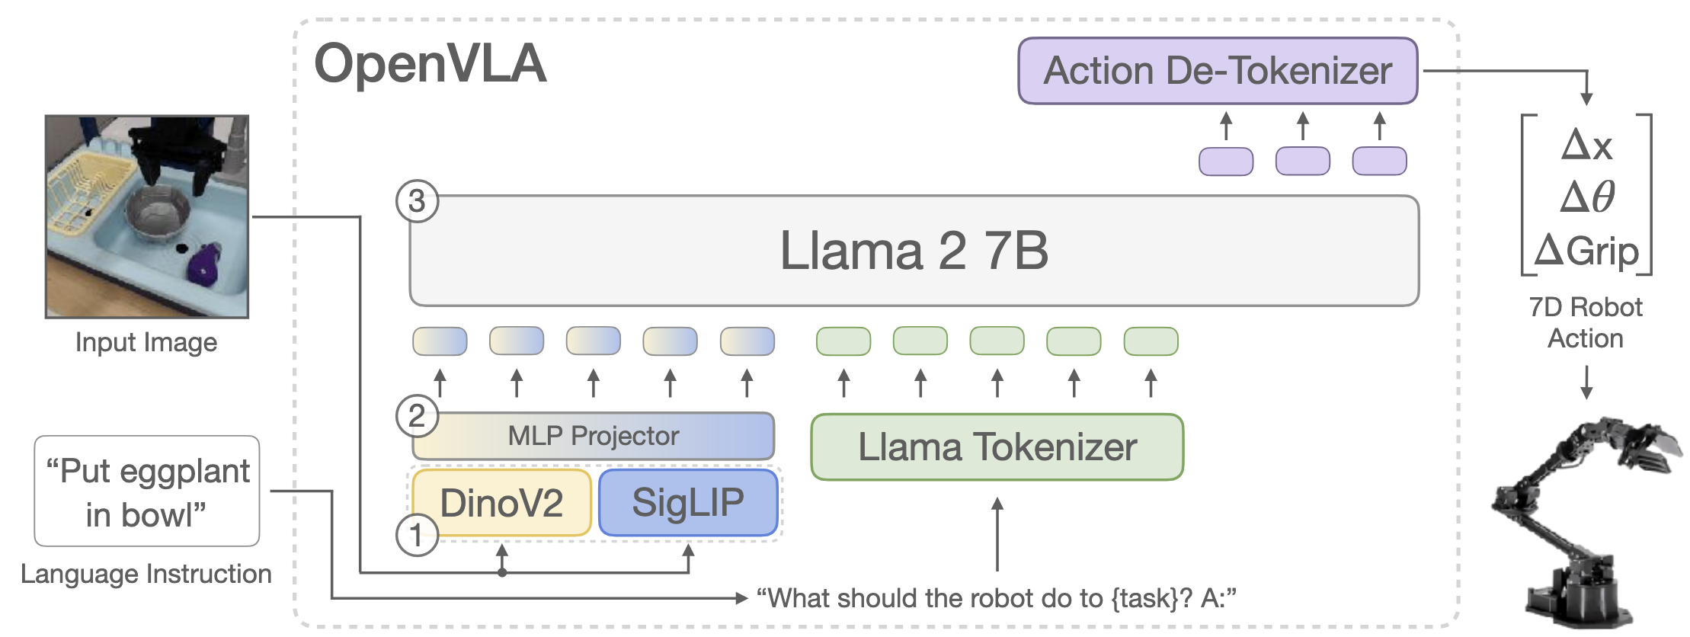
Imitation Learning in foundation models
IL is a main component in foundation models, including the popular Large Language Models (LLMs)
Next token prediciton == imitation learning
In decision-making, Vision Language Action Models (VLAs) are the new SOTA
Predict next robot action from vast “robot data”.
OpenVLA (Kim et al. 2024)

Slide 7
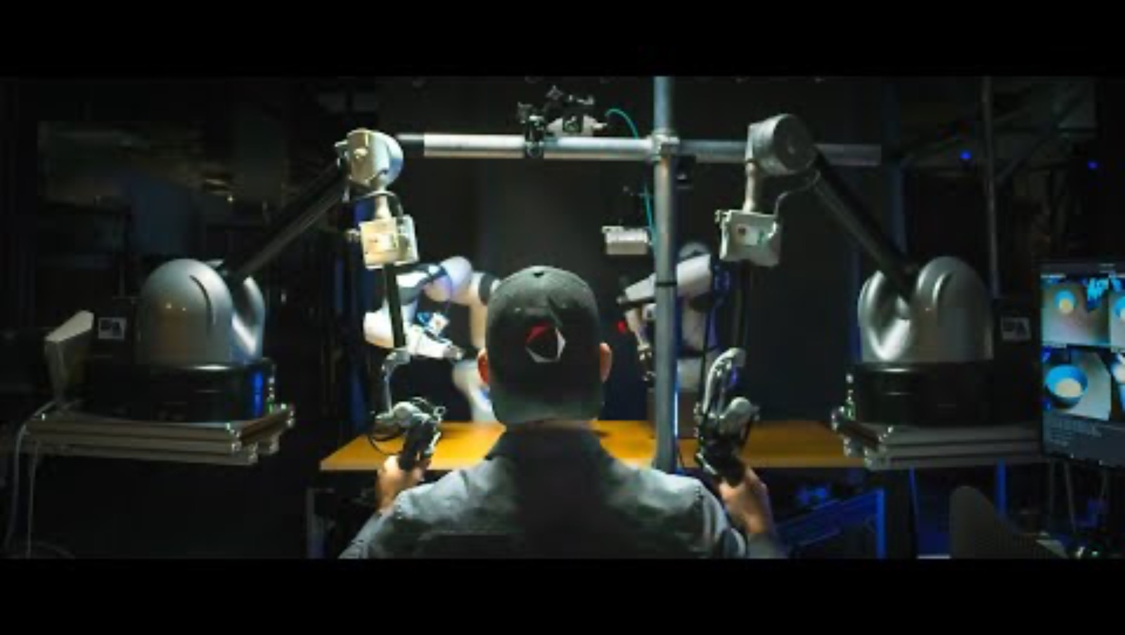
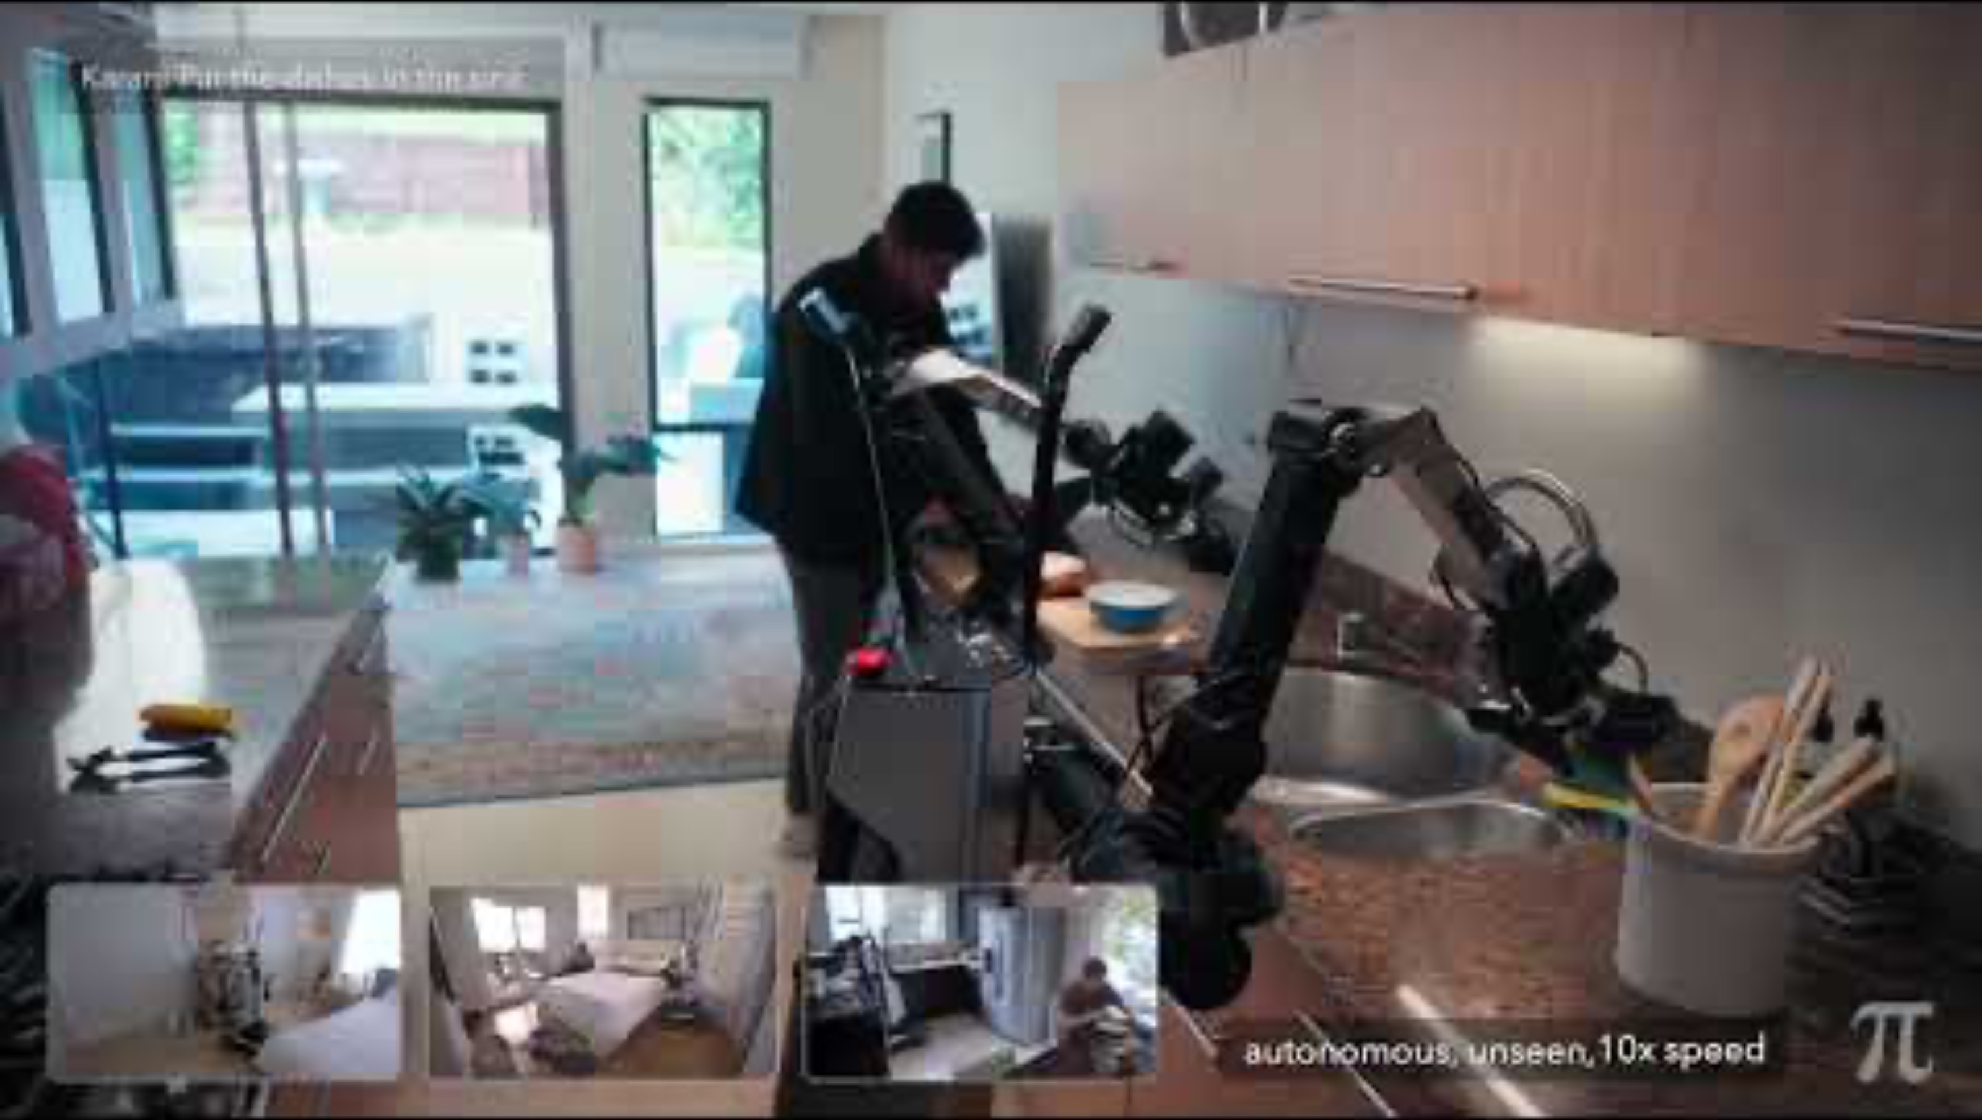
Modern(ish) Imitation Learning

Slide 8
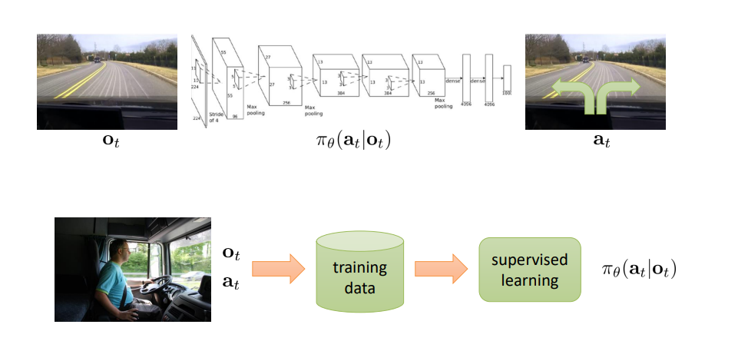
Behavior Cloning

Slide 9
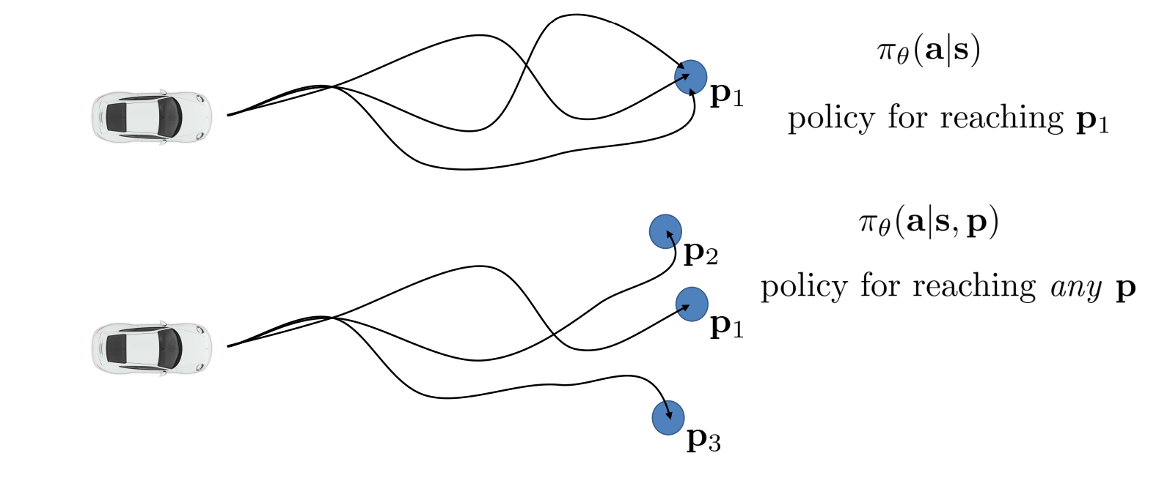

Multi-task Learning
$$i$$

Slide 10
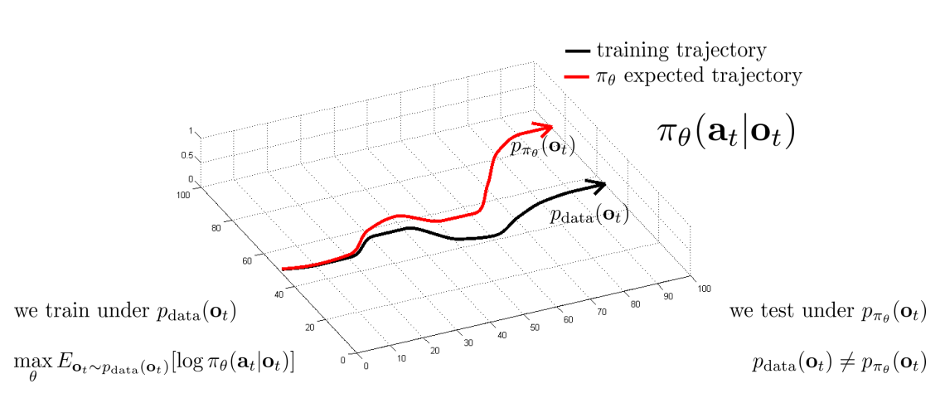
Distributional Shift

Slide 11
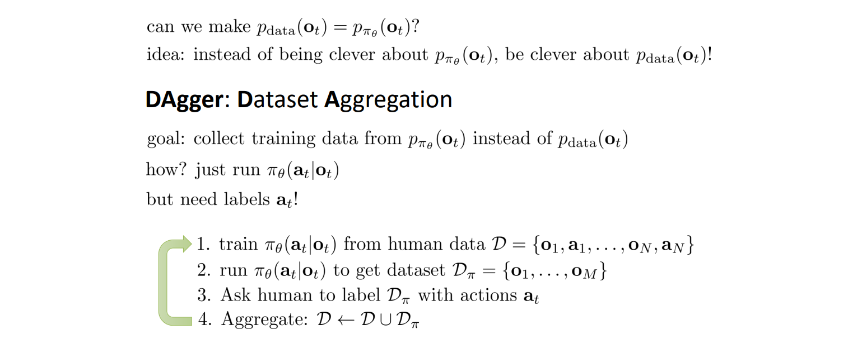
DAgger

Slide 12
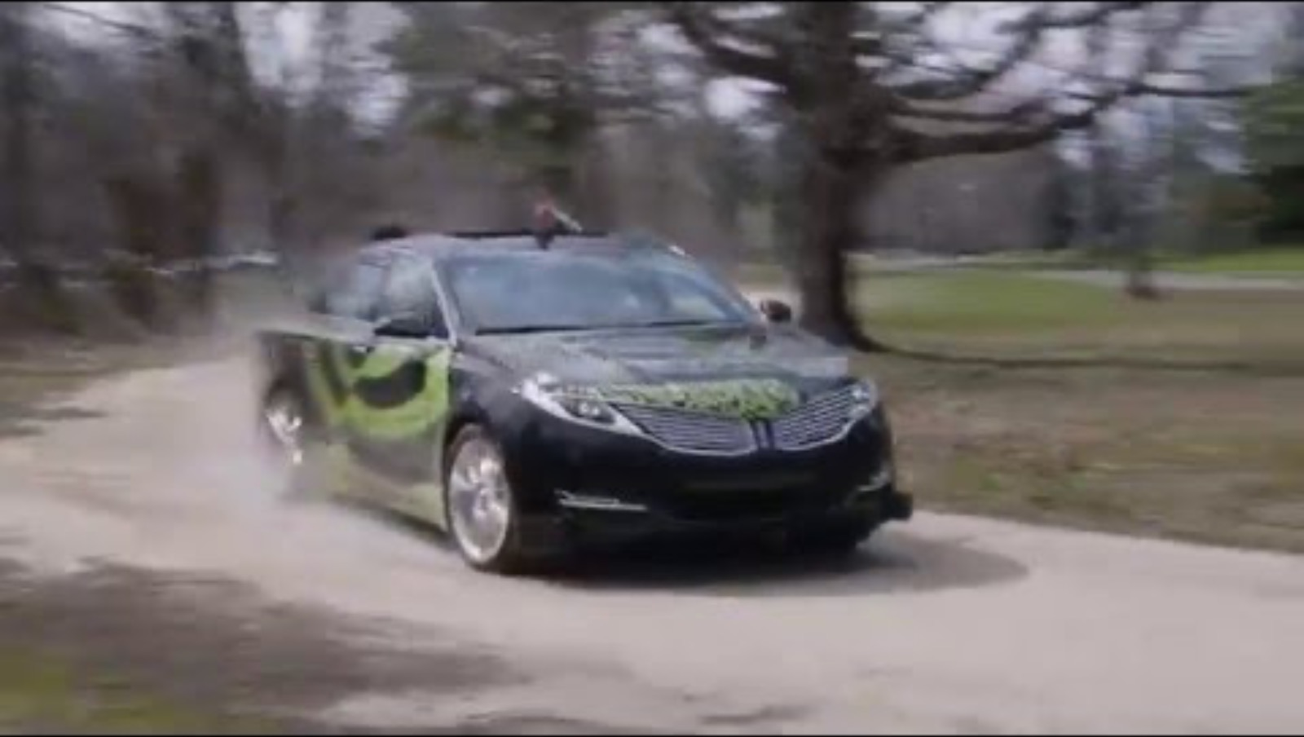
Does it work?

Slide 13
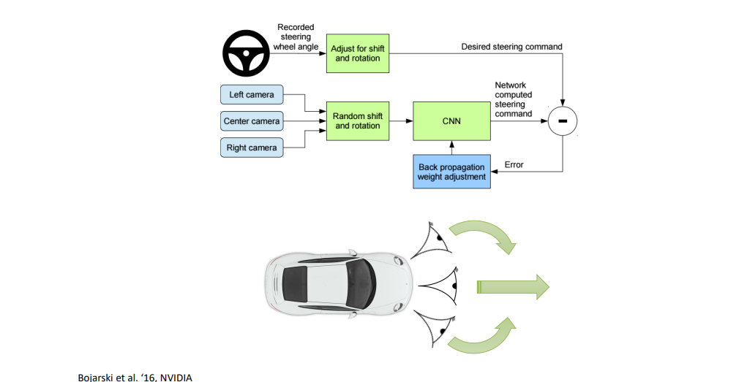
Data Augmentation

Slide 14
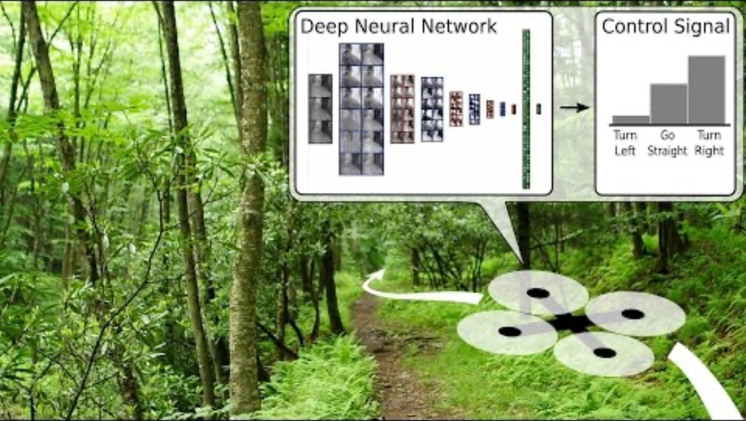
Does it work?

Slide 15
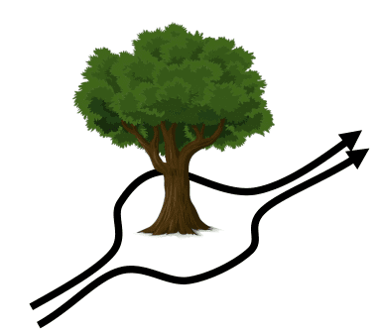
Multimodel Behavior
More than one correct behavior in a given state.
Complex action distributions, especially in continuous action spaces.
Solutions:
Mixture of Gausians
Latent variable models
Diffusion models

Slide 16
History-dependent policies
When the process with which the policy interacts is non-Markovian, expert actions may depend on the history of observations, not just the current state.
In POMDP, this is often the case.
Temporal Dependencies: Recognizing and incorporating temporal dependencies is essential for tasks with non-Markovian behavior.
Sequence Models: Using models like LSTMs or Transformers can help capture these dependencies.
Causal Relationships: Avoiding causal confusion by ensuring the policy learns true causal relationships is critical.

Slide 17
Limitations of IL
Data must be given; unavoidable bottleneck.
In many cases, data is from human behavior; slow to collect
Deep learning works best when data is plentiful
Humans are not good at providing actions to agents.
Requires specialized interfaces, e.g., remote control.
IL policies are limited by the capabilities of the expert policy.
Are there better behaviors we never thought about?
IL policies are static.
Can we create policies that continually learn and improve?

